Slide 1
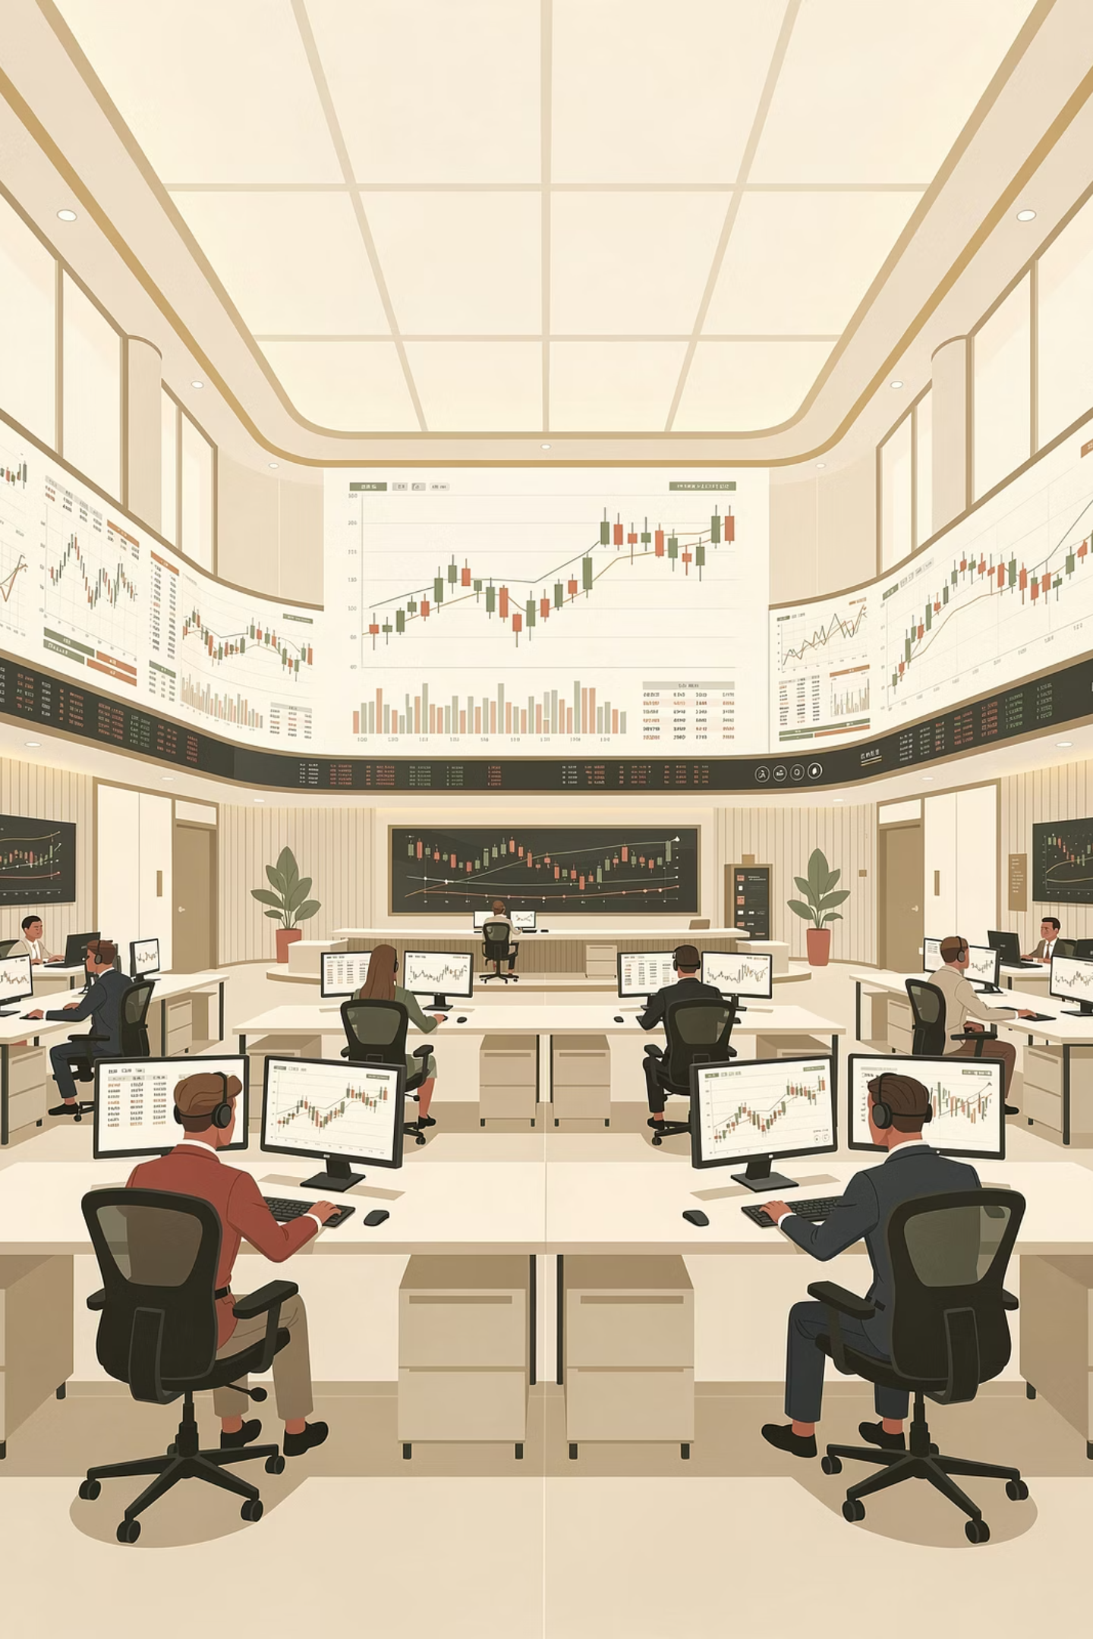
Visualizing Stock Trends with Candlestick Charts and Technical Indicators in Python
A comprehensive exploration of building interactive trading visualizations using Python's powerful data science ecosystem—Pandas, Matplotlib, Seaborn, and Plotly.
Group Members:
Ayushman Mallik, Priyanshu Yadav, Sidharth Gupta, Saksham Gupta, Md Ateef, & Adarsh Pandey

Slide 2
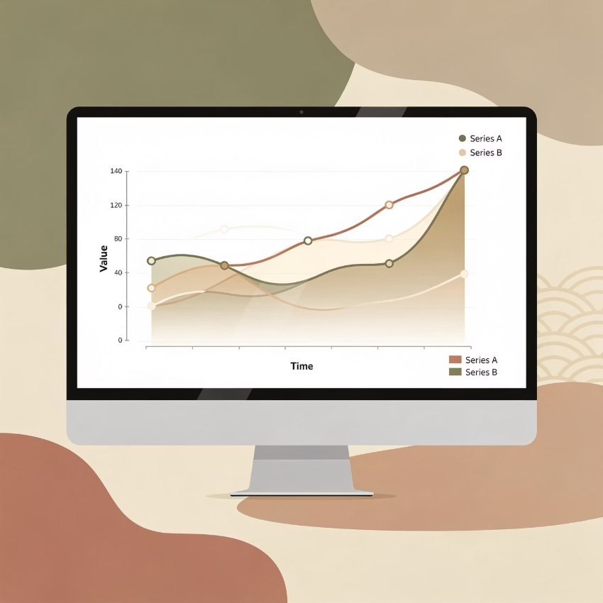




Problem Statement & Objective
The Challenge
Financial markets generate massive volumes of time-series price data daily. Traders and quantitative analysts rely heavily on sophisticated visual tools—particularly candlestick charts and technical indicators—to extract actionable insights from this data deluge.
These visualizations serve critical functions: understanding price trends and momentum, identifying key support and resistance levels, detecting volatility patterns, and pinpointing potential entry and exit points for trading strategies.
Candlestick Prices
Moving Averages
OHLC data visualization showing market sentiment
9 EMA and 12 EMA for trend identification
Bollinger Bands
Volume & Returns
20-period bands with 2σ volatility measurement
Trading activity and distribution analysis

Slide 3
Tools, Libraries, and Environment
1
2
3
Python
Pandas
Matplotlib
Core programming language powering the entire analytical pipeline
Essential for data loading, cleaning, transformation, and sophisticated time-series operations including resampling and rolling calculations
Foundation for static plotting capabilities, enabling detailed distribution plots and custom chart configurations
4
5
Seaborn
Plotly
Statistical visualization library built on Matplotlib, providing elegant styling and specialized plots for returns distribution analysis
Interactive visualization powerhouse creating responsive candlestick charts with hover tooltips, zoom capabilities, and volume subplots
Development Environment: Flexible deployment across local Python environments, VS Code, or Jupyter Notebook, providing iterative development and immediate visual feedback.

Slide 4
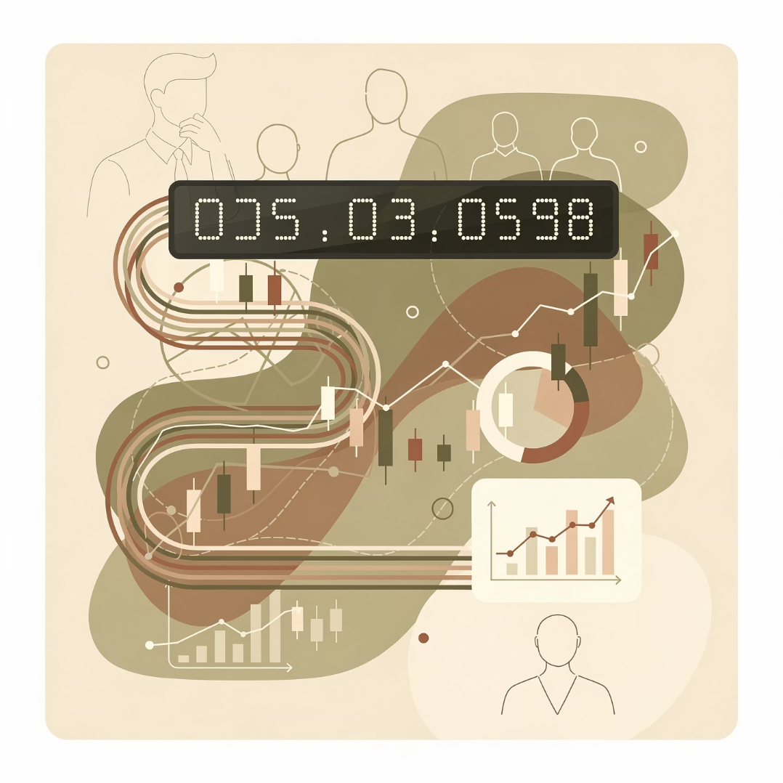


Data Description
Option A: Real Market Data
Option B: Simulated Data
Data Type: Historical OHLCV data (Open, High, Low, Close, Volume)
Data Type: Simulated OHLCV time-series approximating realistic stock behavior
Time Frame: Approximately one year of daily trading data
Reason: Network restrictions preventing access to live financial APIs
Source: Online financial APIs such as Yahoo Finance, Binance, or Stooq
Generation Method: Business day calendar with synthetic but realistic price movements and randomized volume within typical ranges
Columns: Date, Open, High, Low, Close, Volume
Data Integrity: Regardless of source, all data undergoes rigorous validation to ensure proper datetime formatting, sorted chronological order, and numeric type consistency across all OHLCV columns.

Slide 5

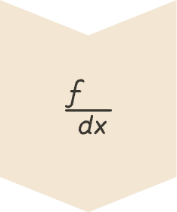


Methodology and Technical Indicators
Data Preparation
Convert Date column to datetime objects, sort chronologically, set as index, and validate numeric types for all OHLCV fields
Calculate EMAs
Compute 9-period and 12-period Exponential Moving Averages on closing prices for short-term trend identification
Bollinger Bands
Generate 20-period middle band (SMA), then upper and lower bands at ±2 standard deviations
Daily Returns
Calculate percentage change in closing price to measure daily price movement and volatility
9 EMA
12 EMA
Bollinger Bands
Short-term trend indicator highly responsive to recent price changes, useful for identifying quick momentum shifts
Slightly longer short-term trend that smooths noise while maintaining sensitivity to price action
Volatility bands that expand during high volatility periods and contract during consolidation phases

Slide 6
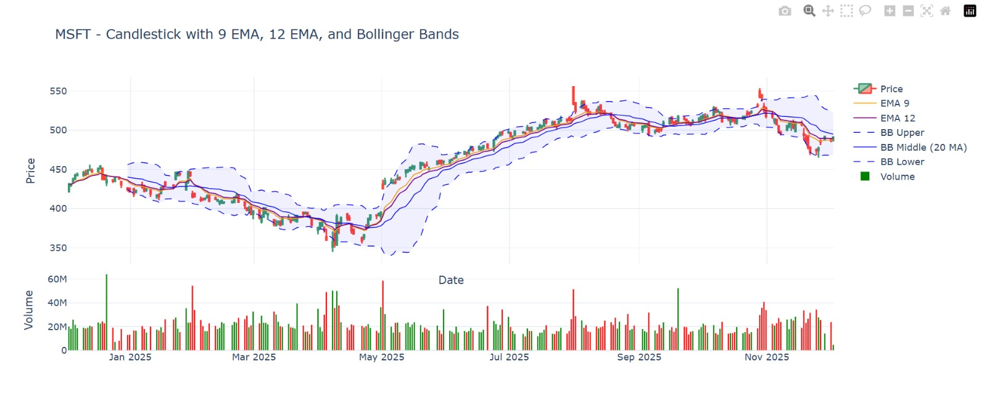
Interactive Trading Chart – Output View

Slide 7
Interactive Candlestick Chart with Indicators
The visualization leverages Plotly's subplot capabilities to create a comprehensive, multi-panel interactive trading dashboard. Each element serves a specific analytical purpose while maintaining visual clarity and user interactivity.
Top Panel: Price Action
1
Candlestick chart displaying OHLC data with color-coded candles (green for up days, red for down days). Overlaid with 9 EMA and 12 EMA trend lines, plus Bollinger Bands featuring upper, middle, and lower bands with shaded volatility zones.
2
Bottom Panel: Volume Analysis
Volume bars synchronized with price action, color-coded to match corresponding price movement—green bars for days with positive returns, red bars for negative returns.
Interactive Features
3
Comprehensive hover tooltips revealing precise OHLC values and indicator readings. Full zoom and pan capabilities with intuitive range navigation controls for detailed time-period analysis.

Slide 8
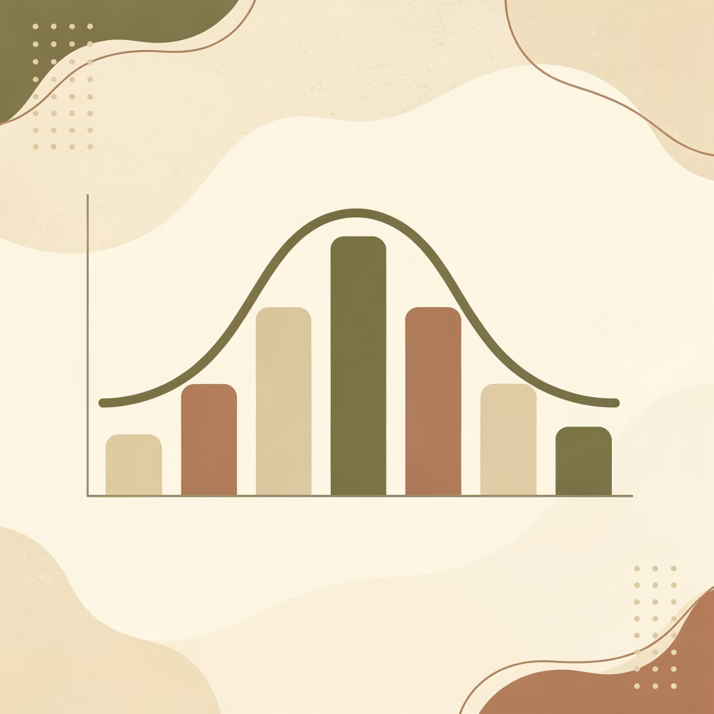
Returns Distribution and Insights
Statistical Analysis
Key Observations
The returns distribution visualization combines a histogram with a kernel density estimation (KDE) curve, created using Seaborn and Matplotlib. This statistical view reveals the underlying probability distribution of daily returns, highlighting volatility characteristics and any skewness in price movements.
Volatility Signals
Periods where price touches or breaks through Bollinger Bands indicate heightened volatility and potential reversal zones
Trend Crossovers
Crossovers between 9 EMA and 12 EMA signal potential short-term trend changes and momentum shifts
Volume-Price Relationship
Volume spikes frequently align with larger candles, confirming strong directional moves with conviction
Return Clustering
The majority of daily returns cluster within a narrow range, revealing the stock's typical volatility profile

Slide 9


Challenges, Limitations, and Conclusion
Challenges Encountered
Restricted network access blocking direct API calls to financial data providers
Complex time-series handling requiring careful date parsing and chronological sorting
Balancing chart clarity with information density—avoiding visual clutter while maintaining analytical value
Project Limitations
Data constraints: Simulated data lacks real market microstructure; real API access limited to single ticker and daily timeframe
Indicator scope: Implementation focused on foundational indicators without advanced strategies or backtesting frameworks
Scalability: Current architecture not optimized for multiple securities or real-time streaming data
Conclusion
We successfully developed a comprehensive interactive trading chart system in Python, integrating candlestick visualizations with 9 EMA, 12 EMA, Bollinger Bands, and volume analysis. The project demonstrates how modern data visualization techniques can transform raw market data into actionable insights, revealing price trends, volatility patterns, and volume-price relationships with unprecedented clarity.
Future Enhancements
Extended Indicators
Multi-Asset Support
Web Dashboard
Add RSI, MACD, Stochastic Oscillator, and other technical analysis tools
Enable simultaneous analysis of multiple tickers across various timeframes including intraday data
Deploy as an interactive web application for broader accessibility and real-time updates

